Slide 1
SASS Tutorial

Slide 2
Intro
Variables
Nesting
Partials
Extends
Mixins
Functions
Dodatno:
Project setup

Slide 3
What is SASS?
SASS (Syntactically Awesome Stylesheet) is a CSS pre-processor, which helps to reduce repetition with CSS and saves time. It is more stable and powerful CSS extension language that describes the style of a document cleanly and structurally.
It was initially designed by Hampton Catlin and developed by Natalie Weizenbaum in 2006. Later, Weizenbaum and Chris Eppstein used its initial version to extend the Sass with SassScript.

Slide 4
Why to Use SASS?
It is a pre-processing language which provides indented syntax (its own syntax) for CSS.
It provides some features, which are used for creating stylesheets that allows writing code more efficiently and is easy to maintain.
It is a super set of CSS, which means it contains all the features of CSS and is an open source pre-processor, coded in Ruby.
It provides the document style in a good, structured format than flat CSS. It uses re-usable methods, logic statements and some of the built-in functions such as color manipulation, mathematics and parameter lists.

Slide 5
Features of SASS
It is more stable, powerful, and compatible with versions of CSS.
It is a super set of CSS and is based on JavaScript.
It is known as syntactic sugar for CSS, which means it makes easier way for user to read or express the things more clearly.
It uses its own syntax and compiles to readable CSS.
You can easily write CSS in less code within less time.
It is an open source pre-processor, which is interpreted into CSS.

Slide 6
Advantages of SASS
It allows writing clean CSS in a programming construct.
It helps in writing CSS quickly.
It is a superset of CSS, which helps designers and developers work more efficiently and quickly.
As Sass is compatible with all versions of CSS, we can use any available CSS libraries.
It is possible to use nested syntax and useful functions such as color manipulation, mathematics and other values.

Slide 7
Disadvantages of SASS
It takes time for a developer to learn new features present in this pre-processor.
If many people are working on the same site, then should use the same preprocessor. Some people use Sass and some people use CSS to edit the files directly. Therefore, it becomes difficult to work on the site.
There are chances of losing benefits of browser's built-in element inspector.

Slide 8
Sass - Installation
In this chapter, we will learn the step-by-step procedure to install Ruby, which is used for executing the SASS files.
https://www.youtube.com/watch?v=skDtB-tQY-I
install node.js
to check installation, in console type node –v npm -v
To install sass, in console type: npm install node-sass –g
To check installation, in console type: node-sass -v

Slide 9
Installation example
The following is a simple example of SASS
<html>
<head>
<title>Import example of sass</title>
<link rel="stylesheet" type="text/css" href="style.css"/>
</head>
<body>
<h1>Simple Example</h1>
<h3>Welcome to SASS Training course</h3>
</body>
</html>

Slide 10
Now, we will create file as style.scss, which is quite similar to CSS and the only one difference is that it will be saved with .scss extension.
Both, .html and .scss files should be created inside the sass folder. You can save your .scss file in the folder ruby\lib\sass\ (before this process, create a folder as sass in lib directory).

Slide 11
style.scss
h1{
color: #AF80ED;
}
h3{
color: #DE5E85;
}

Slide 12
You can tell SASS to watch the file and update the CSS whenever SASS file changes, by using the following command −
node-sass -o css mixins.scss
When you run the above command, it will create the style.css file automatically.
The style.css file will have the following code:
h1 {
color: #AF80ED;
}
h3 {
color: #DE5E85;
}

Slide 13
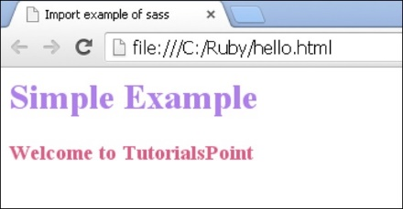
Let us carry out the following steps to see how the above given code works
Save the above given code in hello.html file.
Open this HTML file in a browser.

Slide 14
Sass - Syntax
In this chapter, we will study about SASS Syntax. SASS supports two syntaxes namely SCSS and Indented syntax.
The SCSS (Sassy CSS) is an extension of CSS syntax. This means every valid CSS is a valid SCSS as well. SCSS makes much easier to maintain large stylesheets and can recognize vendor specific syntax, Many CSS and SCSS files use the extension .scss.
Indented − This is older syntax and sometimes just called as SASS. Using this form of syntax, CSS can be written concisely. SASS files use the extension .sass.

Slide 15
Using Sass
Example 1
$primaryColor: #eeffcc;
body {
background-color: $primaryColor;
}
.wrapper {
color:red;
}
/*
body {
background-color: green;
}
*/

Slide 16
Sass - CSS Extensions
In this chapter, we will study about CSS Extensions. CSS Extensions can be used to enhance the functionality of the web pages. The following table lists down some of the CSS extensions used in SASS
Nested Rules - It is a way of combining multiple CSS rules within one another.
Referencing Parent Selectors: & - It is the process of selecting parent selector by using the & character.
Nested Properties - It allows nesting of properties into other properties which leads to grouping of another related code.
Placeholder Selectors - Sass supports placeholder selector using class or id selector by making use of @extend directive.

Slide 17
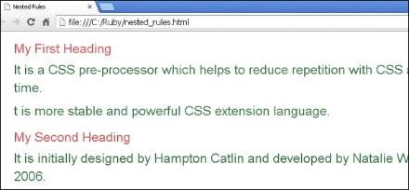
Sass - Nested Rules
Nesting is combining of different logic structures. Using SASS, we can combine multiple CSS rules within one another. If you are using multiple selectors, then you can use one selector inside another to create compound selectors.

Slide 18
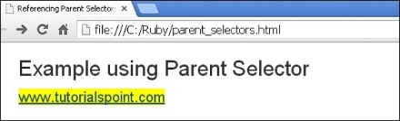
Sass - Referencing Parent Selectors
You can select the parent selector by using the & character. It tells where the parent selector should be inserted.

Slide 19
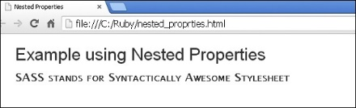
Sass - Nested Properties
Using nested properties, you can avoid rewriting CSS multiple times.
For instance, use font as namespace, which uses some properties such as font-family, font-size, font-weight and font-variant.
In normal CSS, you need to write these properties every time with namespace.
Using SASS, you can nest the properties by writing the namespace only once.

Slide 20
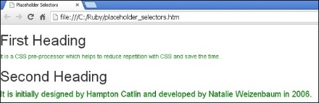
Sass - Placeholder Selectors
SASS supports placeholder selector using class or id selector.
In normal CSS, these are specified with "#" or ".", but in SASS they are replaced with "%".
To work with placeholder selector, they can be used with @extend directive.
Without using @extend directive, you cannot display the result in CSS.

Slide 21
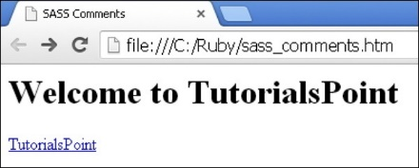
Sass - Comments
In this chapter, we will study about Sass Comments. Comments are non-executable statements, which are placed in source code. Comments make source code easier to understand. SASS supports two types of comments.
Multiline comments − These are written using /* and */. Multiline comments are preserved in CSS output.
Single line comments − These are written using // followed by comments. Single line comments are not preserved in CSS output.

Slide 22
Sass - Variables
Programmers use variables to represent data, such as numeric values, characters or memory addresses.
The importance of variables is, you can reuse the stored values in the variable throughout the stylesheet
Example: $variable_name : some value;

Slide 23
DataTypes
S.No. | Data Type & Description | Example
1 | Numbers It represents integer types. | 2, 10.5
2 | Strings It is sequence of characters defined within single or double quotes. | 'Tutorialspoint', "Tutorialspoint"
3 | Colors It is used for defining color value. | red, #008000, rgb(25,255,204)
4 | Booleans It returns true or false boolean types. | 10 > 9 specifies true
5 | Nulls It specifies null value which is unknown data. | if(val==null) {//statements}
6 | Space and Comma Represents the values which are separated by spaces or commas. | 1px solid #eeeeee, 0 0 0 1px
7 | Mapping It maps from one value to another value. | FirsyKey: frstvalue, SecondKey: secvalue

Slide 24
Sass - Operations
Number Operations - It allows mathematical operations such as addition, subtraction, multiplication and division
Color Operations - It allows using color components along with the arithmetic operations.
String Operations - It uses + operation to concatenate strings.
Boolean Operations - You can perform Boolean operations on SASS script by using and, or and not operators.
List Operations - Lists represent series of values, which are separated using commas or space. For information about lists, see the lists section under data types section.

Slide 25
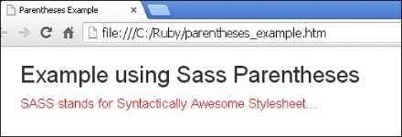
Parantheses
Parentheses are a pair of signs, which are usually marked off by round brackets ( ) or square brackets [], providing symbolic logic that affect the order of operations.

Slide 26
Functions
SASS supports the use of functions by providing some keyword arguments, which are specified using normal CSS function syntax.
HSL stands for hue, saturation, and lightness, which are more intuitive for creating a set of matching colors by using saturation and lightness.
hue − It represents the degree of color such as 120 for red, 240 for green, 290 for pastel violet etc.
saturation − It is a percentage value that increases the saturation of color.
lightness − It is a percentage value which decreases the lightness of color.
Syntax: p {
color: hsl($hue: 0, $saturation: 50%, $lightness: 50%);
}

Slide 27
Interpolation
It provides SassScript variables in selectors and property names using #{ } syntax.
You can specify variables or property names within the curly braces.
Syntax: #{$name}

Slide 28
& in SassScript
You can select the parent selector by using the & character. It tells where the parent selector should be inserted.
a {
&:hover { color: green; }
}

Slide 29

Variable Defaults
You can set the default values for variables by adding !default flag to the end of the variable value.
It will not re-assign the value, if it is already assigned to the variable.

Slide 30
Rules and Directives
@import - It imports the SASS or SCSS files, it directly takes the filename to import.
@media - It sets the style rule to different media types.
@extend - @extend directive is used to share rules and relationships between selectors.
@at-root - @at-root directive is a collection of nested rules, which is able to make style block at root of the document.
@debug - @debug directive detects the errors and displays the SassScript expression values to the standard error output stream.
@warn - @warn directive is used to give cautionary advice about the problem; it displays the SassScript expression values to the standard error output stream.
@error - @error directive displays the SassScript expression value as fatal error.

Slide 31
Rules and Directives – import (1/2)
Import directives, imports the SASS or SCSS files. It directly takes the filename to import. All the files which are imported in SASS will get combined in a single CSS file. There are few things that are compiled to a CSS when we use @import rule:
File extension .css
Filename begins with http://
Filename is url()
@import consist any media queries.
Examples:
@import "style.css";
@import "http://tutorialspoint.com/bar";
@import url(style);
@import "style" screen;

Slide 32
Rules and Directives – import (2/2) - Partials
Partials are SASS or SCSS files, which are written using underscore at the beginning of the name (_partials.scss).
The partial file name can be imported in SASS file without using the underscore. SASS does not compile the CSS file.
By using the underscore, it makes SASS understand that it is partial and should not generate the CSS file.

Slide 33
Rules and Directives - media
@media directive sets the style rule to different media types.
@media directive can be nested inside the selector SASS but it is bubbled up to the top level of the stylesheet.

Slide 34
Rules and Directives - extend
The @extend directive is used to share rules and relationships between selectors.
It can extend all another class styles in one class and can also apply its own specific styles.

Slide 35
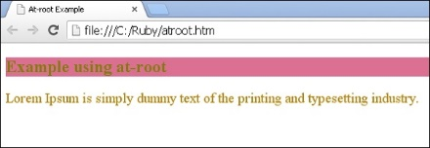
Rules and Directives - at-root
The @at-root directive is a collection of nested rules which is able to make the style block at root of the document.

Slide 36
Rules and Directives - debug
The @debug directive detects the errors and displays the SassScript expression values to the standard error output stream.

Slide 37
Rules and Directives - warn
The @warn directive is used to give cautionary advice about the problem. It displays the SassScript expression values to the standard error output stream.

Slide 38
Rules and Directives – error
The @error directive displays the SassScript expression value as fatal error.

Slide 39
Sass - Control Directives & Expressions
if() - Based on the condition, if() function returns only one result from two possible outcomes.
@if - The @if directive accepts SassScript expressions and uses the nested styles whenever the result of the expression is anything other than false or null.
@for - The @for directive allows you to generate styles in a loop.
@each - In @each directive, a variable is defined which contains the value of each item in a list.
@while - It takes SassScript expressions and untill the statement evaluates to false it iteratively outputs nested styles.

Slide 40
Sass - Mixin Directives
Mixins allow creating a group of styles, which are reusable throughout your stylesheet without any need to recreation of non-semantic classes.
In CSS, the mixins can store multiple values or parameters and call function; it helps to avoid writing repetitive codes.
Mixin names can use underscores and hyphens interchangeably.
Following are the directives present in Mixins:
Defining a Mixin - @mixin directive is used to define the mixin.
Including a Mixin - @include directive is used to include the mixins in the document.
Arguments - The SassScript values can be taken as arguments in mixins, which is given when mixin is included and available as variable within the mixin.
Passing Content Blocks to a Mixin - Block of styles are passed to the mixin.

Slide 41
Function Directives
In SASS, you can create your own function and use them in your script context or can be used with any value.
Functions are called by using the function name and with any parameters.
Example:
#set_width { padding-left: adjust_width($n: 10); }

Slide 42

Literatura:
https://www.tutorialspoint.com/sass/

